Slide 1


UTILISATION & CAPACITY
Will Burton
Notes:
Good afternoon my name is Will and I will be presenting my team’s exploratory and explanatory analysis into concerns around the NHS’s capacity and utilisation of services
The overall data date range covers a tumultuous time for the NHS with lockdowns, backlogs and seasonal elements all playing a role in shaping capacity and exactly how resources are utilised.
Throughout this report I will highlight data quality and data reporting issues. While these data issues are acknowledged in the metadata, for this project it means that it is difficult to find actionable insights from the data as quality, and completeness, are both significant issues.
As such all insights, analysis and suggestions must be appreciated within a context of an exploration of imperfect data and taken as guidance.

Slide 2
Addressing the main business questions
Has there been adequate staff and capacity in the networks?
What was the actual utilisation of resources?
Notes:
This is how I have focused on the two main business questions: Capacity
What was the average capacity of the NHS during the data period and how often was this capacity reached?
Utilisation
Where and when were resources utilised?
What resources were utilised, and how?
Who utilised these resources, and who was providing care?
We were asked to consider Twitter too, however the data provided did not prove useful and isn’t in this presentation. There was a lack of geographical relevance and ethical concerns that made extraction problematic.
With that said, through cleaned, ethical and geographically relevant keyword/hashtag analysis, we could legitimately track engagement across users to gather insights about capacity and utilisation of NHS services.
Potential methodology of this has been explored and explained in the technical report.

Slide 3
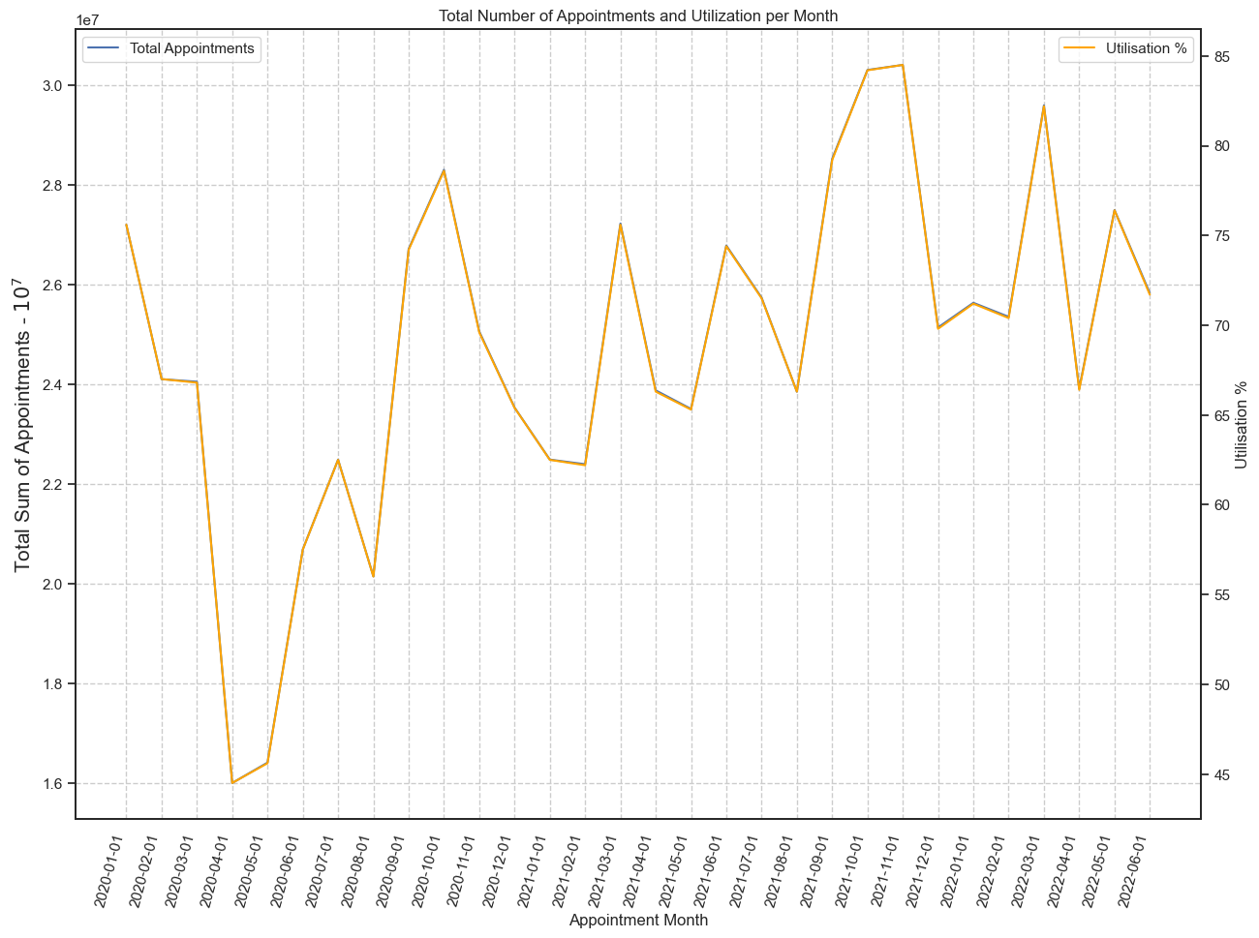
Capacity – 65% average capacity but not the whole story
Capacity
=
“the capability, in terms of available resources, that the NHS has to deliver services”
Maximum Daily Capacity
1,200,000 appointments
=
Notes:
The NHS defines capacity as “a broad term used to describe the capability, in terms of available resources, that the NHS has to deliver services”
The Y axes collectively show us utilisation percent by total sum of appointment in the 10s of millions.
Utilisation of services is based on the NHS guideline of a maximum daily capacity.
1,200,000 appointments and, while there is a peak of 85% and a low of 45%, total average capacity usage of the NHS across the data set is 65%.
This suggests that the NHS is, on average, is operating at 35% under capacity, which could reflect wasted resources.

Slide 4
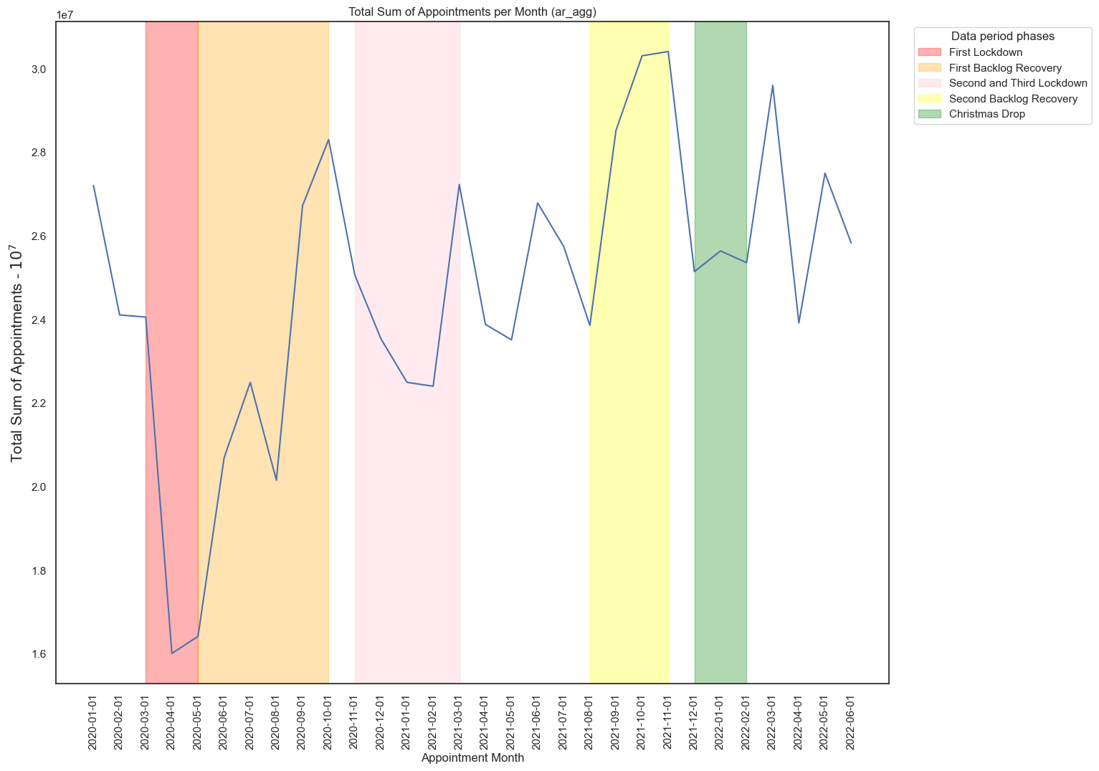
Capacity – a varied and testing time for the NHS
Notes:
However, as you can see from the shading, there are three lockdowns, two backlog recovery periods and the rise of the omicron variant during the natural seasonal dip in appointments.
So, directly addressing the question “Has there been adequate staff and capacity in the networks?” is complex.
Considering the NHS in England did not rise above 85% capacity during what has been called “the most extreme pressure seen in recent history”
you could reasonably argue that yes, there was adequate capacity.
In order to best address the issue of capacity more data and more detail is needed. To explore this and the data period phases above please see the technical report.
Now, let's delve deeper into capacity and explore the utilisation of available resources that informed our national-level analysis. Specifically when are these appointments taking place.

Slide 5
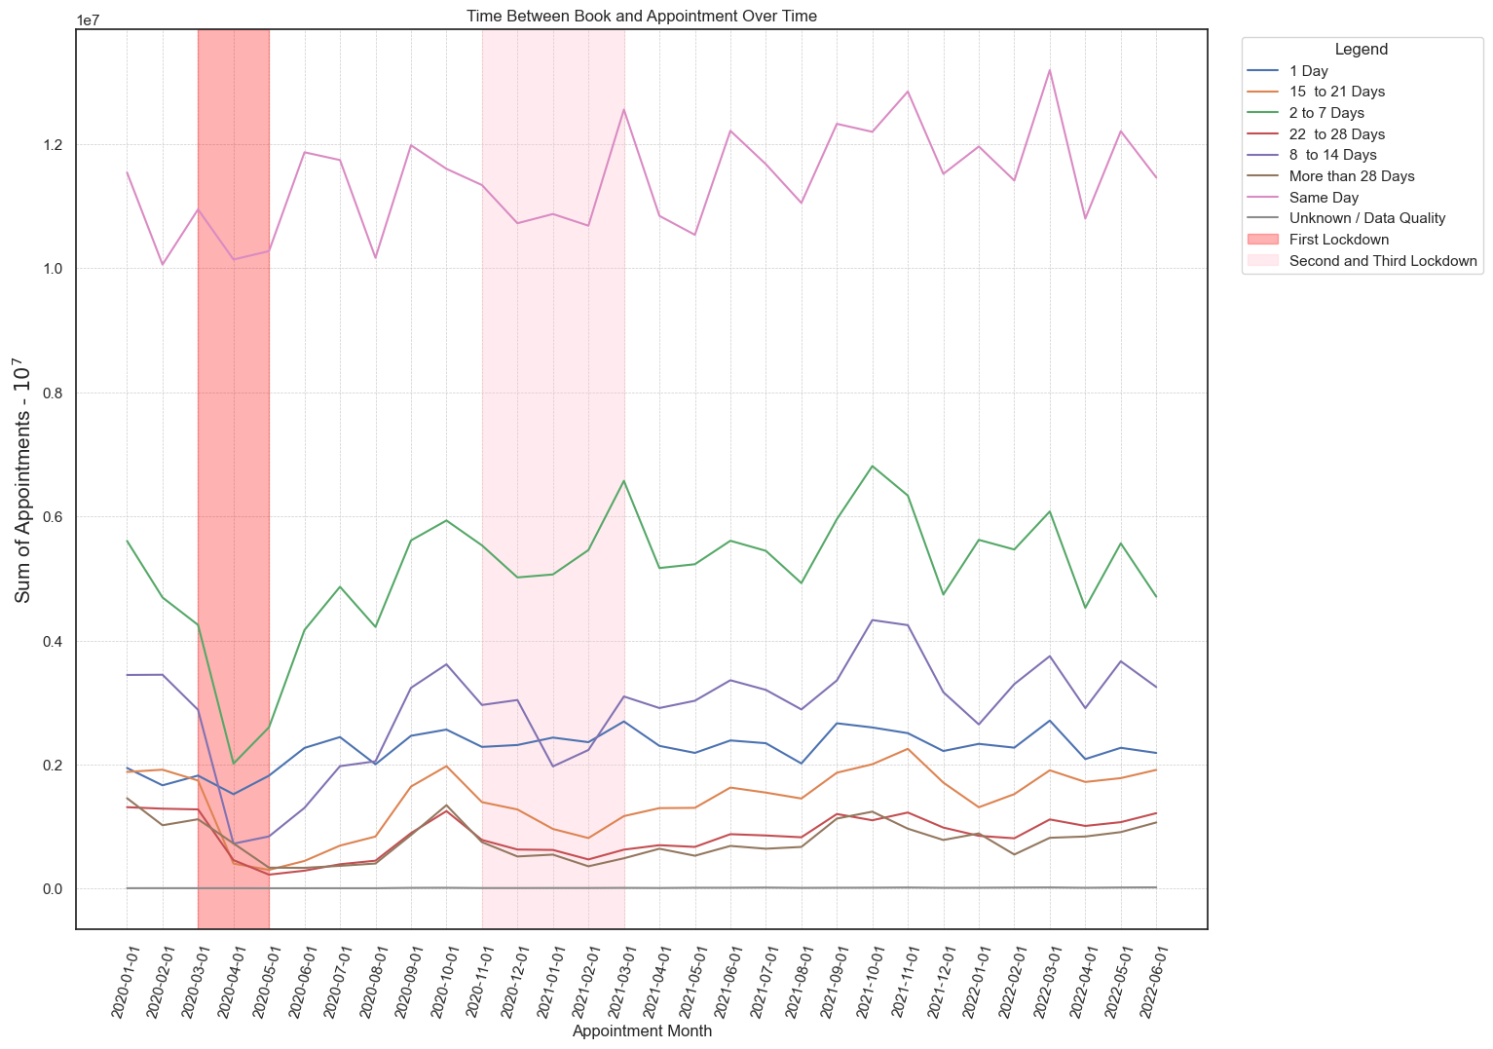
Utilisation – Lockdowns show significant drops
Notes:
As we saw earlier, the NHS never operated at 100% capacity during the data period, so delays could reflect an issue with actual utilisation of resources rather than capacity.
This chart represents the time elapsed between patients booking and the appointment date.
The red columns are national lockdowns, and it’s clear to see that all appointment delay segments dropped accordingly.
There is no clear target for appropriate delay booking and appointments, so I have put forward a suggestion made by Therese Coffey when she was Health Secretary
She argued that “No one should wait more than two weeks to see GP .”
As such that will be our metric.

Slide 6
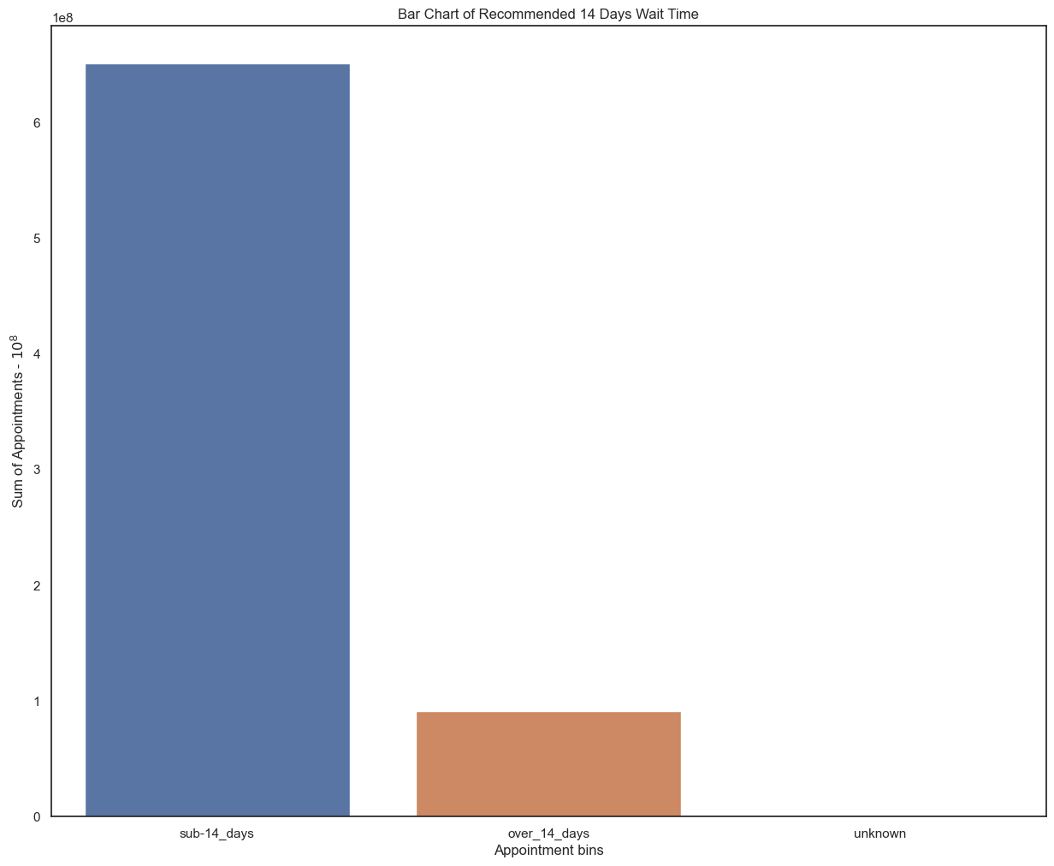

Utilisation - 88% of appointments reach target
46% patients seen same day
“No one should wait more
than two weeks to see GP .”
88%
Thérèse Coffey 2022
3% of patients seen in more than 28 days
12%
Notes:
By grouping the time ranges into two bins of sub 14 days and over 14 days we can see the distribution of appointments that achieve the former health secretary’s standard.
The majority of appointments, (88%) take place within 14 days of having been booked. What’s more, 46% percent of patients are seen on the same day!
However 12% of appointments do not achieve the standard. Which might not seem much, but that’s around 91 million appointments in total.
Only 3% of appointments elapse more than 28 days but that’s still around 23 million who have been unable to receive care in an appropriate amount of time.
So who is using and who is giving the appointments?

Slide 7
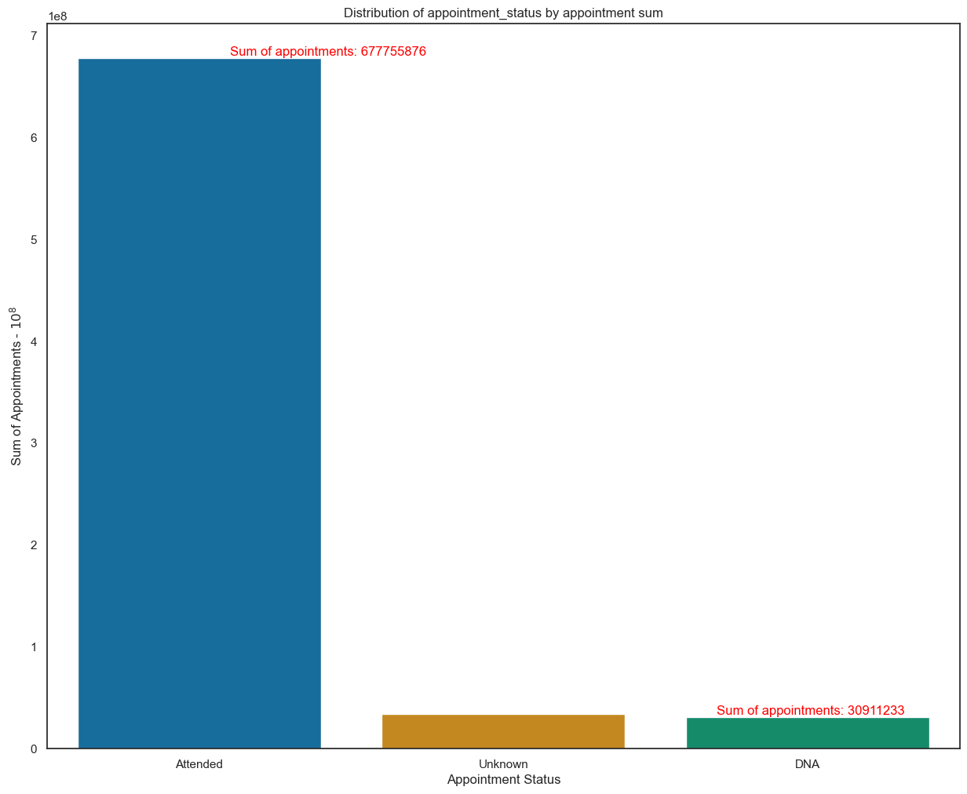


Utilisation – 4% of appointments missed is significant
91%
927 million
£30 cost per missed appointment
5%
4%
Notes:
In a 2019 NHS report, it was calculated that each missed appointment costs an average of £30.
So, while only 4% of appointments were not attended, this amounts to just over 30 million appointments.
In monetary terms, the total cost of missed appointments from January 2020 to June 2022 could be estimated at around £927 million.
Aside from missed appointments, we again see similar data quality issues, with 5% of appointment status data being reported as Unknown (another 30 million or so appointments)
And whilst NHS can’t account for patient absences, it can control where and how staff spend their time, so next let’s look at how staff are being distributed across the network.

Slide 8
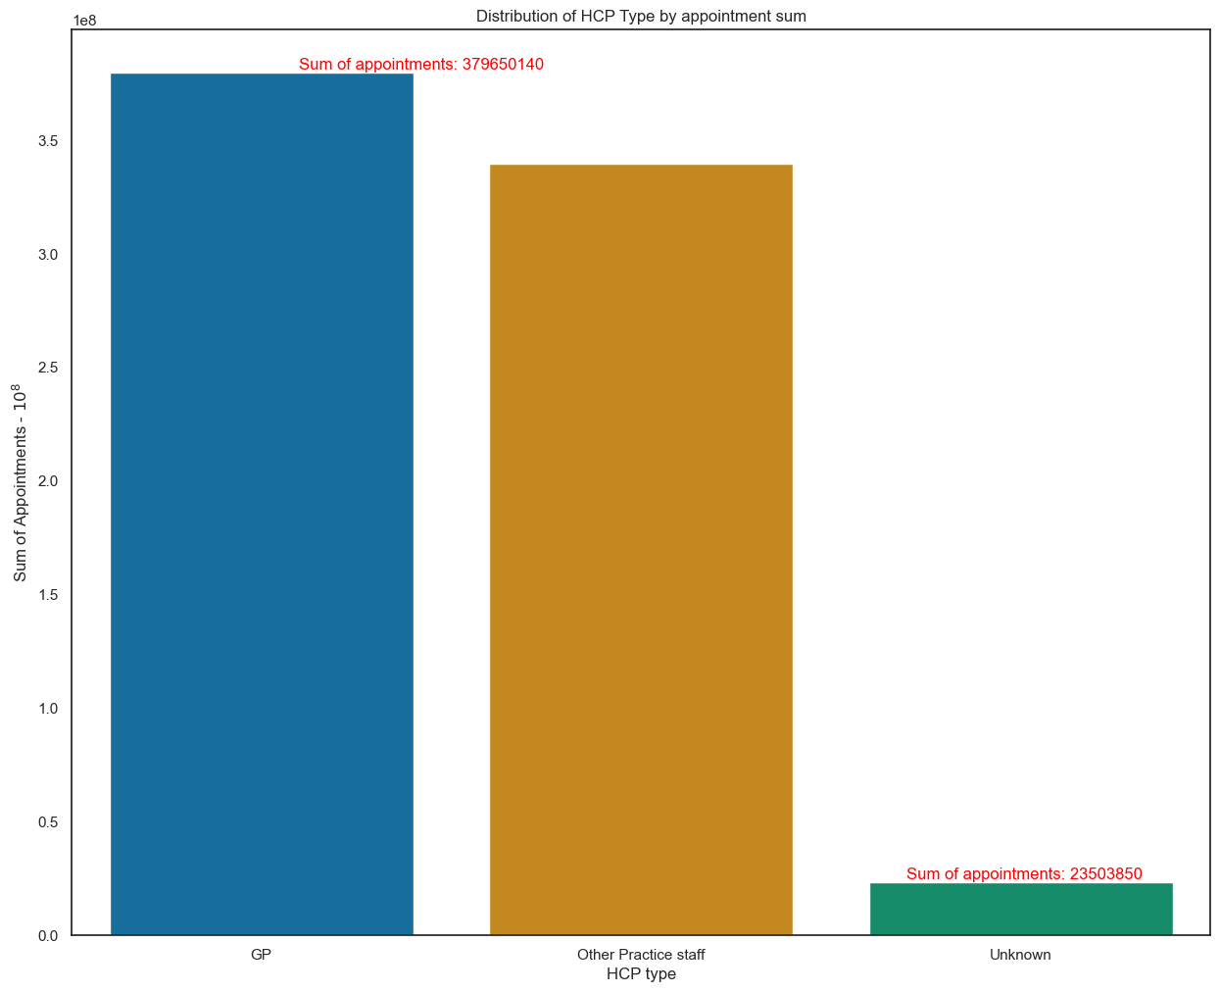
Utilisation – other practice staff almost equal gp’s
30% of GP interruptions were inappropriate or could have waited
51%
40% of interruptions have been dealt with by a more junior member of the clinical team
46%
3%
Notes:
The bar chart shows most appointments by Healthcare Professional Type and we see that GP’s are responsible for 51% of appointments, Other Practice Staff 46% and Unknown 3%.
Worth noting that “other practice staff” includes a long list from nurses to acupuncturists. It would be useful in future to have the detail available on these members of staff to facilitate utilisation analysis of resources at a more granular level.
In an article published by the NHS Pickering Medical Practice they talk about how they managed to reduce their GP appointment waiting times by 47%
They saw that “30% of GP interruptions were inappropriate or could have waited, a further 40% of interruptions could have been dealt with by a more junior member of the clinical team. ”
These insights and many others that can be found in the technical report make it clear that other practice staff have a vital role to play in freeing up GP’s to offer more specialist services to patients.
By understanding how GP’s and other practice staff are spending their time we might better understand efficiency.

Slide 9
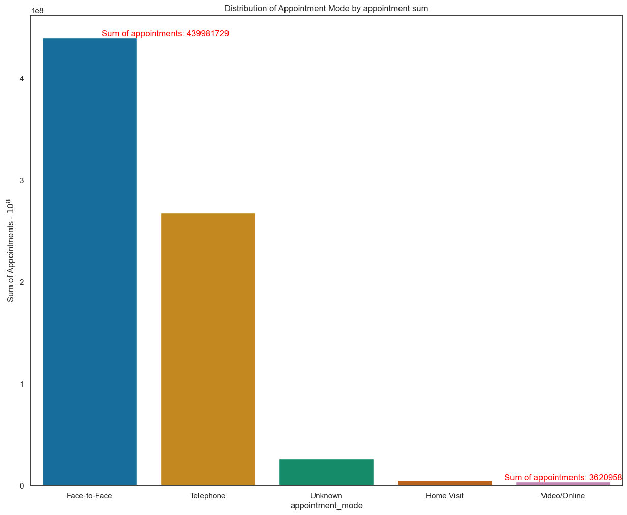
Utilisation – Face to face leads the way
59%
36%
Notes:
Here we can see clearly that face to face appointments are by far and away the most used appointment mode at 59% compared to telephone’s 36%.

Slide 10
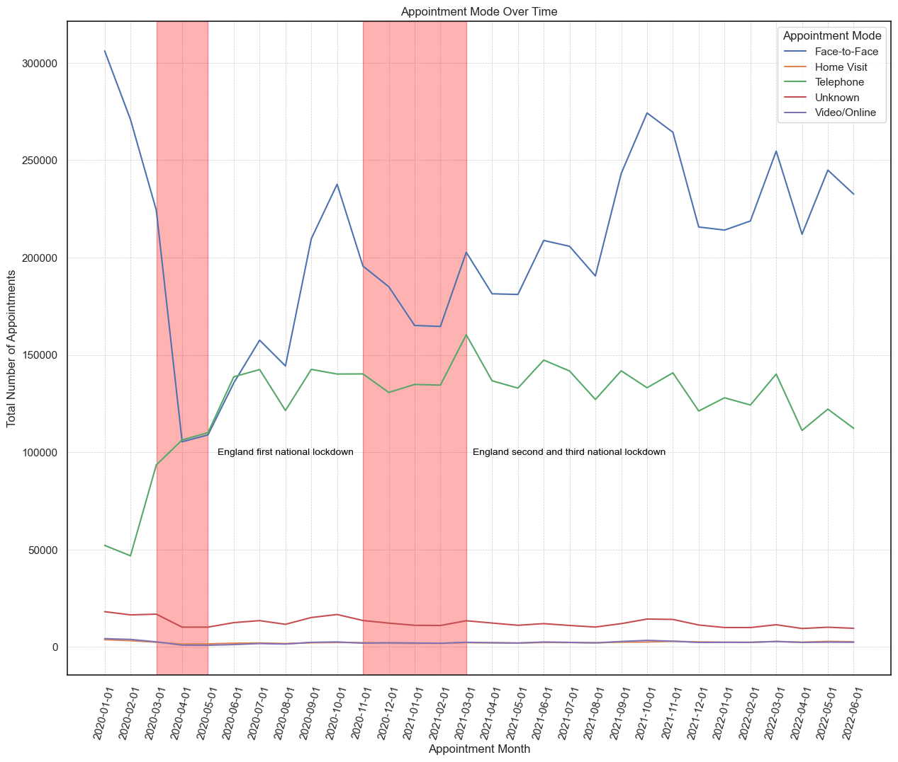
Utilisation – appointment mode shows inefficiencies
Notes:
Sum of appointment mode appointments per month shows us that while there is some fluctuation, face to face steadily comes out on top
The first lockdown shows a sharp decline in face to face appointments which is neatly met by an appropriate rise in telephone appointments.
There is another rise for telephone appointments in the second and third lockdowns but for the most part, telephone appointments gradually lose their momentum where face to face regains it.

Slide 11
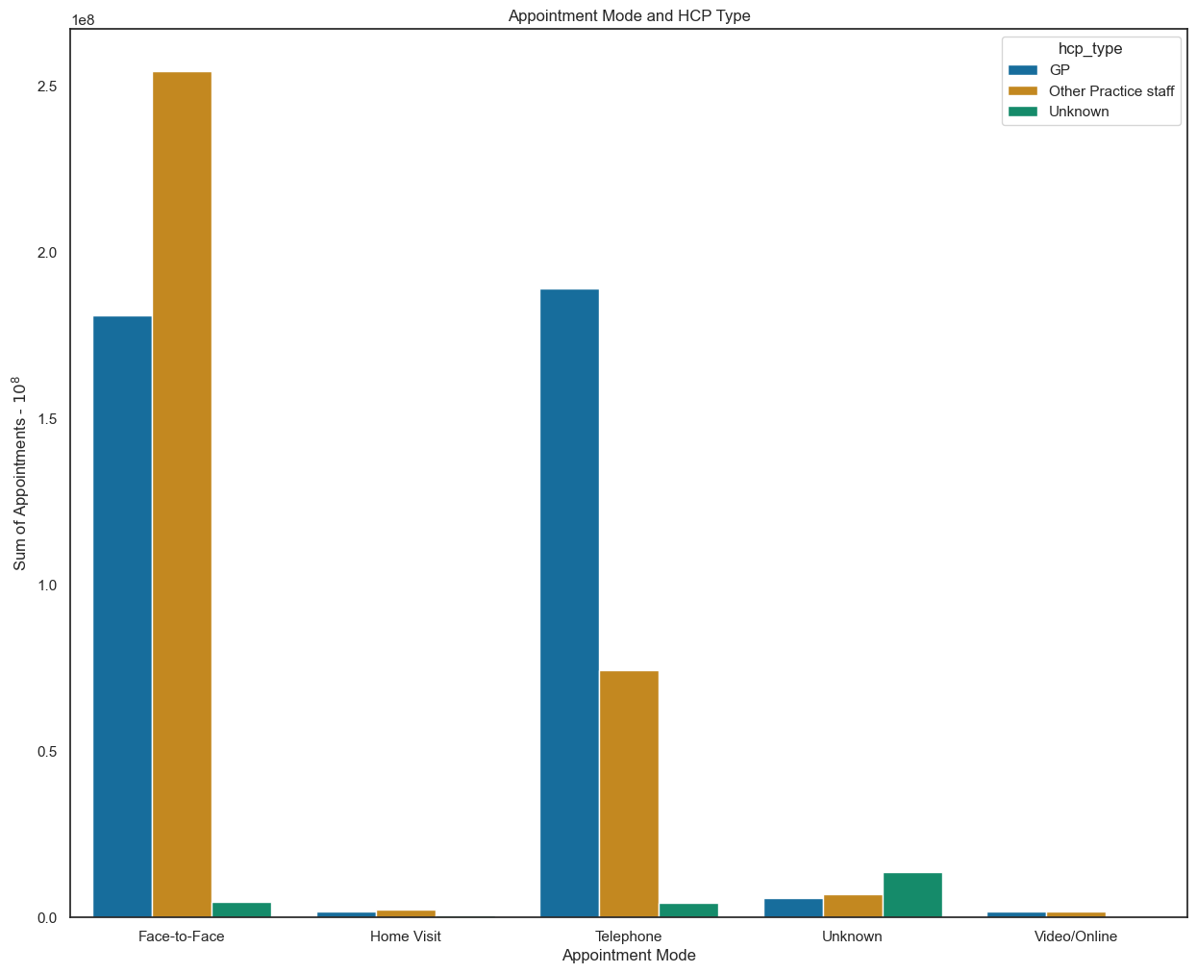
Utilisation – reorganise appointment mode staff allocation
“For every one face to face appointment a GP can deal with two patient calls, freeing up capacity to deal with more patients.”
NHS Pickering
Notes:
By comparing which healthcare professionals fulfil which appointment types , we see that GPs are making 41% face to face appointments compared to other practice staff’s 58%, but that ratio could still be increased.
Returning to NHS Pickering now who suggest that “For every one face to face appointment a GP can deal with two patient calls, freeing up capacity to deal with more patients.” We see in telephone appointments, that ratio should be increased.
Now we’ve explored how Healthcare professionals are carrying out each appointment, let’s see how long they’re spending in each session.

Slide 12
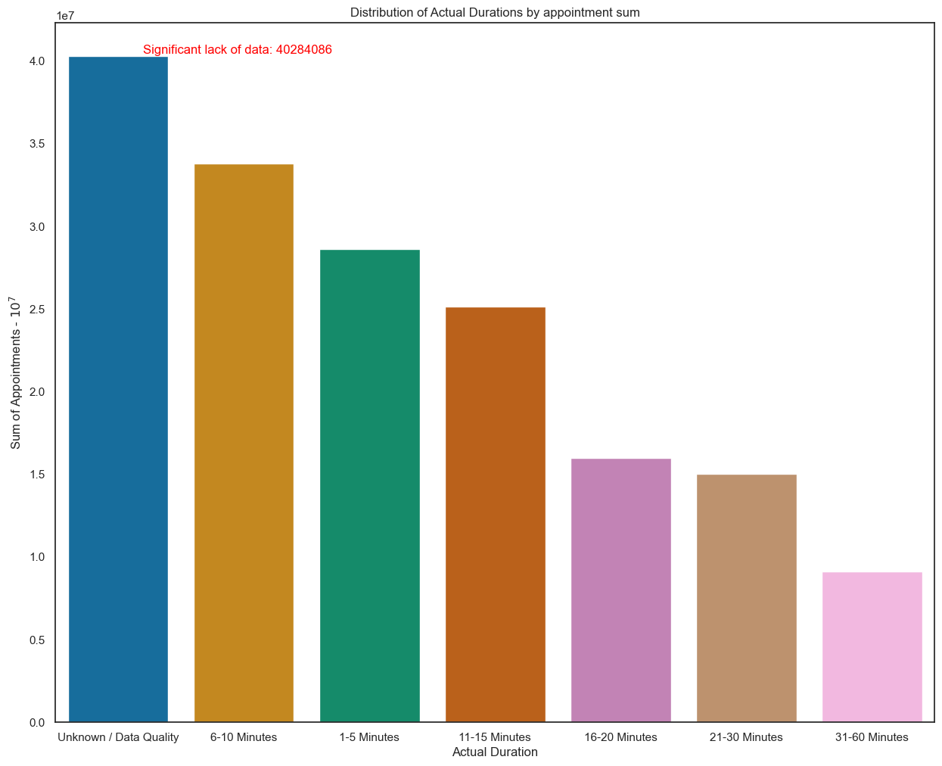
Utilisation – Inefficiencies are shown in appointment length and data reporting
24%
“By extending appointments to 15 minutes, practices can reduce the need for repeated consultations with patients whilst still preserving quality of care and patient satisfaction.”
British Medical Association
Notes:
Inefficiencies are shown in appointment length and data reporting
24% of appointments misreported/unreported because of data quality, around 40 million appointments total.
Finding an appropriate target time for appointment duration is difficult, however The British Medical Association has a suggested figure of 15 minutes.

Slide 13
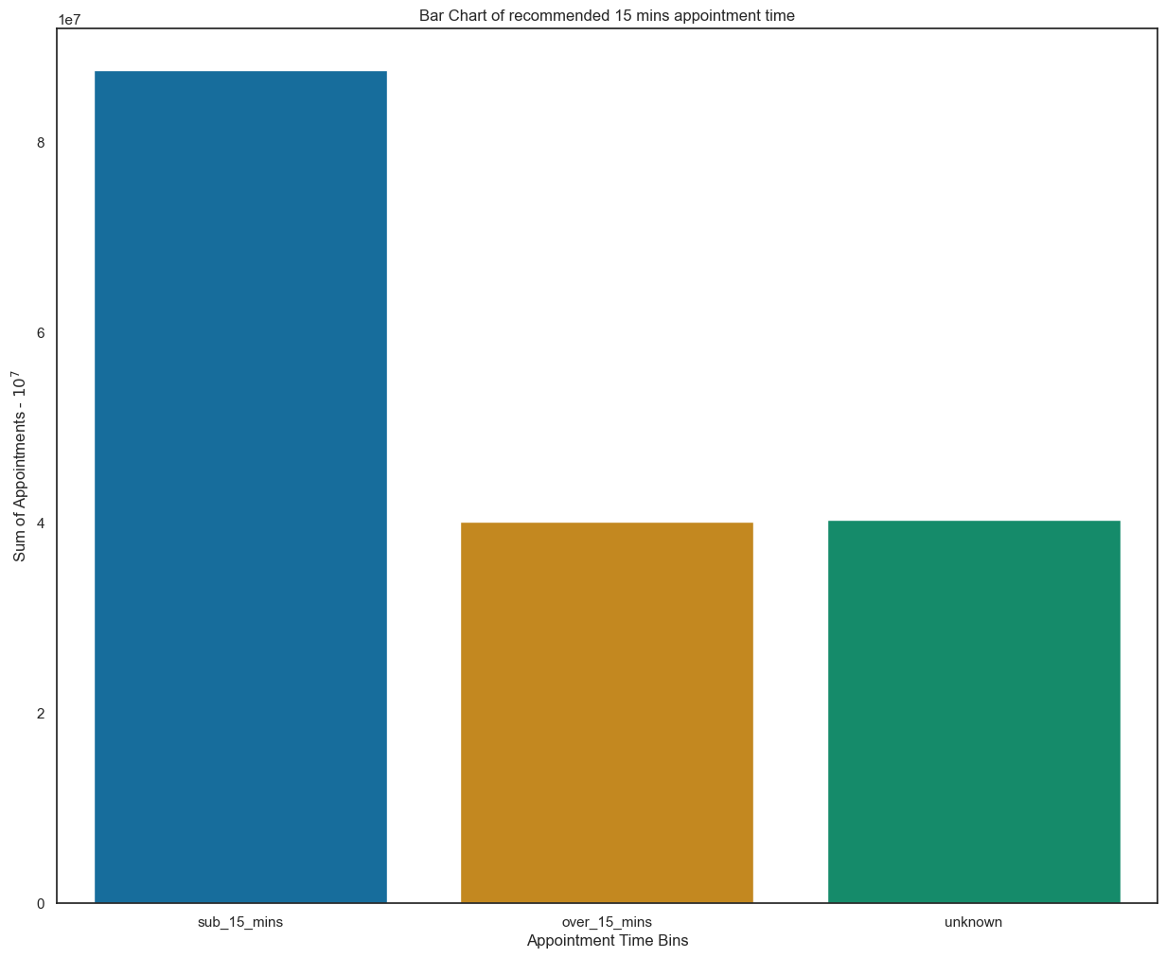
Utilisation – 52% of appointments meet the BMA’s standard
“By extending appointments to 15 minutes, practices can reduce the need for repeated consultations with patients whilst still preserving quality of care and patient satisfaction.”
46% of total appointments
are same day
52%
9 million appointments over 30 mins
British Medical Association
24%
Notes:
By grouping the data into sub 15 mins and over 15 mins bins we can see that 52% of appointments meet the BMA’s standard.
Appointments over 15 minutes account for 24%, around 40 million appointments. Very similar to the unknown column.
Around 9 million appointments are over 30 minutes.
Aside from resolving data collection issues, it’s clear that further guidance is needed to ensure that healthcare professionals are using time efficiently

Slide 14
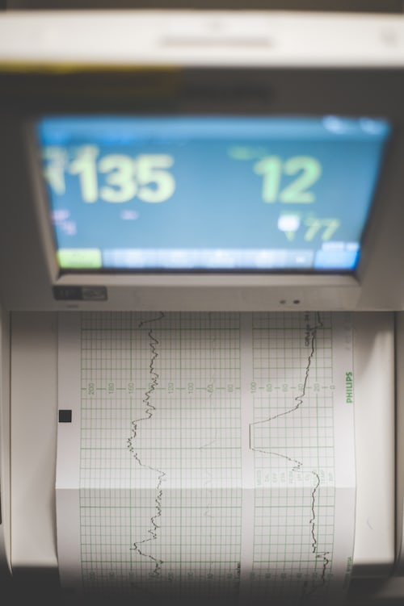
Analytic recommendations
“It is a capital mistake to theorize before one has data.”
Sherlock Holmes in “A study in Scarlet”
Notes:
If analysis is the heart of solid business decisions, raw data is the blood.
The metadata highlights that the data was not originally designed for analysis, lacking national standards for data entry and resulting in widespread data quality issues. This poses a significant risk to analysis, and there is a need for efforts to establish standard data practices in order to avoid losing hundreds of millions of appointments worth of data.
While merging data sets is possible by aggregating up daily data to monthly it is complex and inefficient. Rather in the future, data provided can be at an icb_level and reporting can be standardised to monthly so as to avoid any issue and allow for more direct comparisons of relevant metrics and KPI’s.

Slide 15
Insights & recommendations
1) Capacity
2) General Practice
- More data is needed over a larger date range
- This has to include pandemics, for a fairer assessment of capacity
- To reduce face-to-face appointments by increasing modes such as telephone appointments to free up crucial GP time.
- Support other practice staff in handling appropriate GP appointments.
- Promote centralisation through Primary Care Networks for enhanced efficiency in a move away from traditional understanding of General Practice.
- And emphasise adherence to appropriate sub 15 minute appointment duration.
3) Attendance
- Non-attendance by 4% of patients could cost the NHS around £927 million in the data period.
- Continue the shift towards alternative healthcare professionals, administration and appointment types.
- This can only serve to help to provide more options for patients who can’t reliably commit.
4) Twitter
Twitter data proved less directly useful, but potential insights can be unlocked through cleaned, ethical analysis using relevant keywords and hashtags.
Notes:
There are two main paths: reorganise current resources or expand and upgrade capacity.
Average capacity is around 65% during a tumultuous period for the NHS.
But to more accurately consider this problem, more data is needed over a larger date range, including pandemics, for a fairer assessment of capacity.
To meet the demands of a growing population, increasing capacity will be inevitable. However, in the short term, efficient reallocation of resources could prove pivotal.
91% of appointments are in general practice.
The majority of these patients are seen within the recommended 14-day target, but 91 million appointments fall short.
GPs handle 51% of appointments, while Other Practice Staff manage 46%.
And only 52% of appointments meet the BMA's sub-15 minute duration standard.
In order to address these my recommendations are:
To reduce face-to-face appointments for GP’s encouraging alternative means like telephone or video/online appointments.
Support other practice staff in handling appropriate GP appointments.
Promote centralisation of appointment administration through Primary Care Networks
Despite high attendance, 40 million appointments are missed.
Non-attendance by 4% of patients could cost the NHS around £927 million in the data period.
Finally, Twitter data proved less directly useful, but potential insights can be unlocked through cleaned, ethical analysis using relevant keywords and hashtags.

